Slide 1
GPT 2: Language Model
Presented By:
Elza Cherian

Slide 2
Content
Introduction
Original Transformer model
GPT-2 Model
Difference between GPT-2 and BERT
Basic Working
Self Attention VS Masked Attention
Modifications in Transformer Model
Architecture of GPT-2
GPT-2 Working
Byte Pair Encoding
Working of BPE
Positional Encoding
Context in sentences
Self attention mechanism
Calculating Self attention
Output
Create Query, Key, Value vectors
Masked attentions
Multi head attention

Slide 3
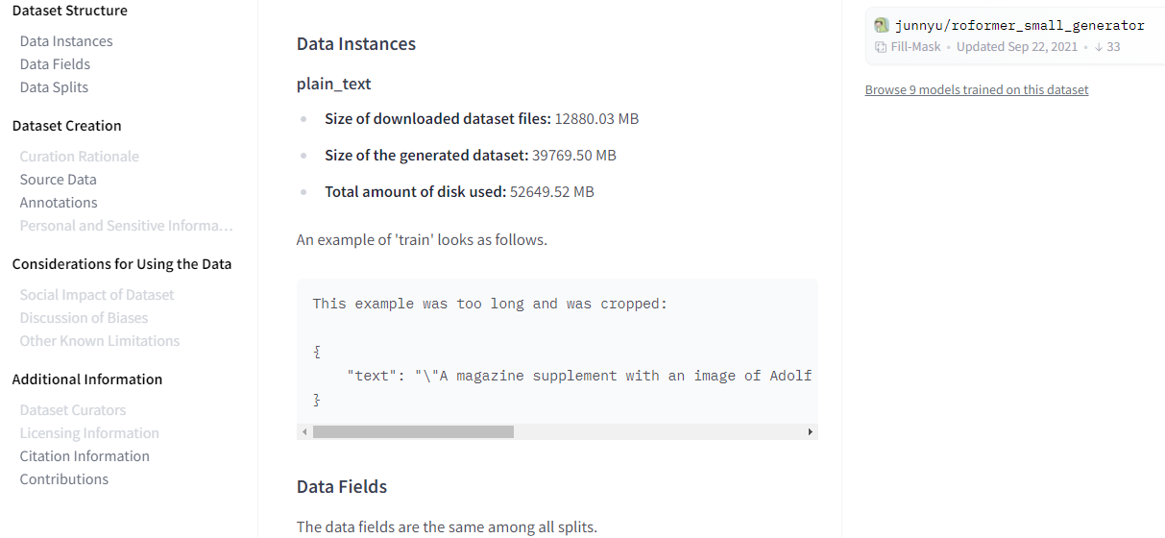
Introduction
A very large, transformer-based language model with 1.5 billion parameters trained on a massive dataset (8 million web pages)
Has next word prediction feature of a keyboard app, but much larger and more sophisticated
Trained on a massive 40GB dataset called WebText that the OpenAI researchers crawled from the internet

Slide 4
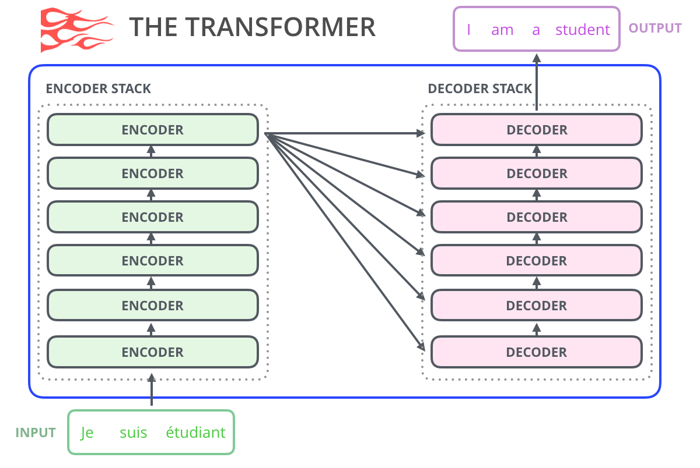
Original Transformer Model
Made up of an encoder and decoder – each is a stack of transformer blocks

Slide 5
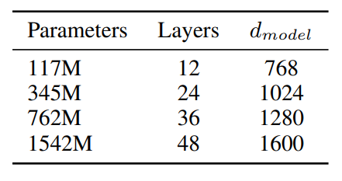
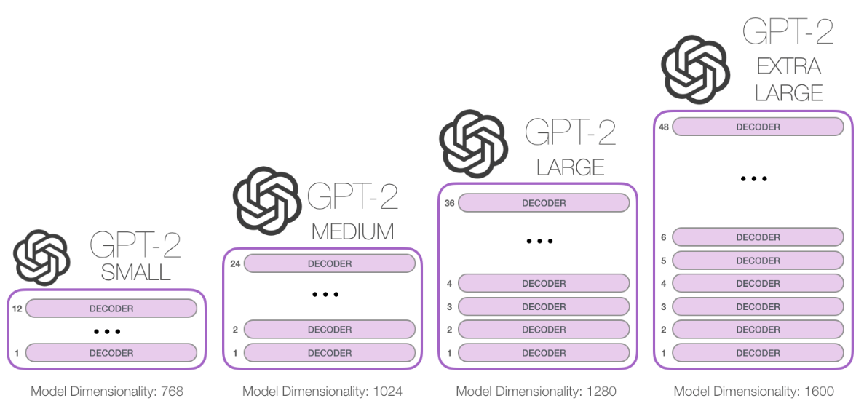
GPT 2 Model
GPT-2 is built using only transformer decoder blocks and based on number of blocks size of model changes

Slide 6
Difference between GPT-2 and BERT
GPT-2 is built using transformer decoder blocks.
BERT uses transformer encoder blocks
GPT2, like traditional language models, outputs one token at a time.

Slide 7
Basic Working
After each token is produced, that token is added to the sequence of inputs.
And that new sequence becomes the input to the model in its next step.
This idea: “auto-regression”.
In losing auto-regression, BERT gained the ability to incorporate the context on both sides of a word to gain better results.

Slide 8
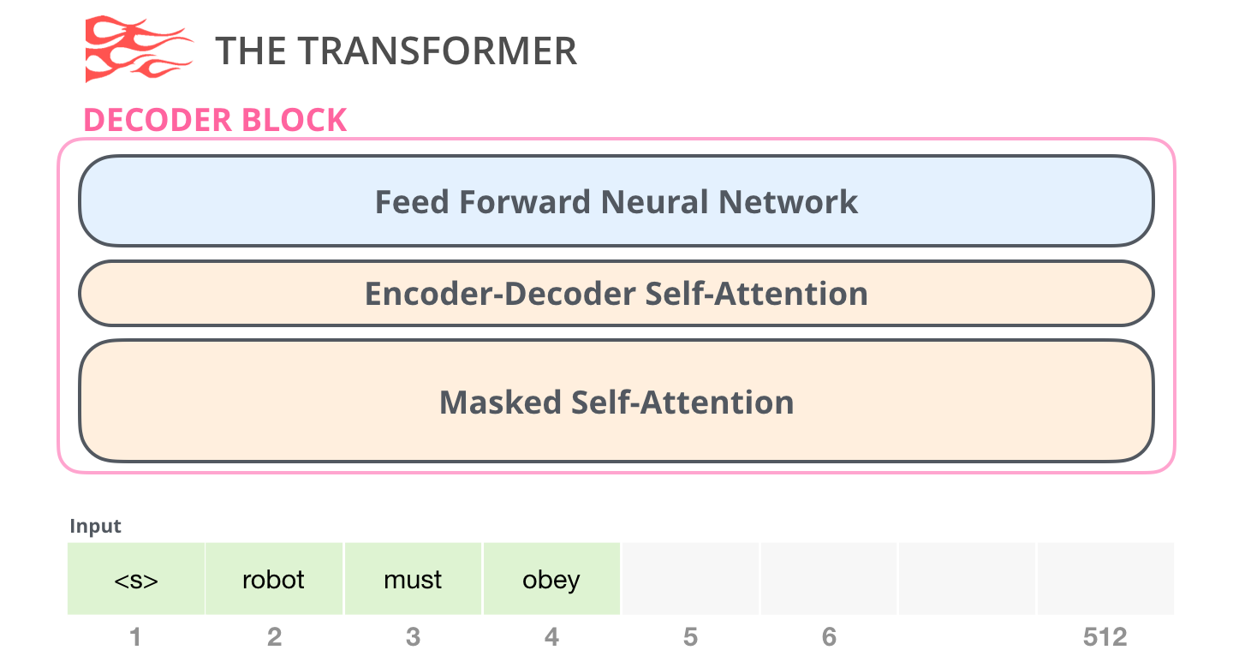
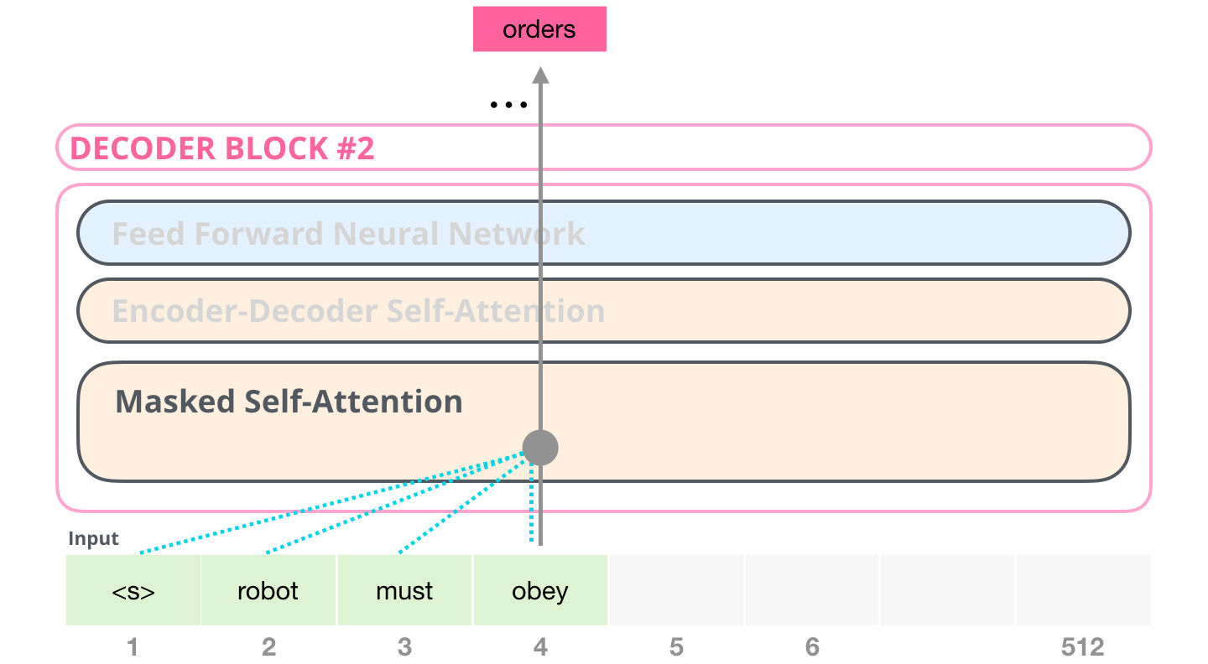
It masks future tokens – not by changing the word to [mask] like BERT, but by interfering in the self-attention calculation blocking information from tokens that are to the right of the position being calculated.

Slide 9
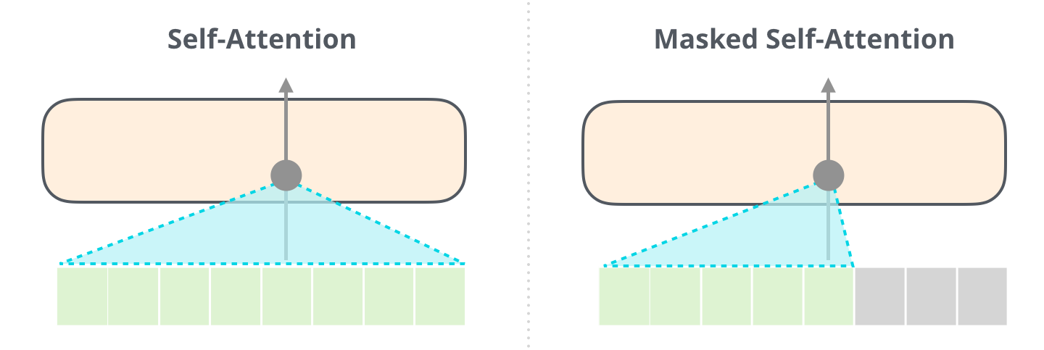
Self Attention VS Masked Attention

Slide 10
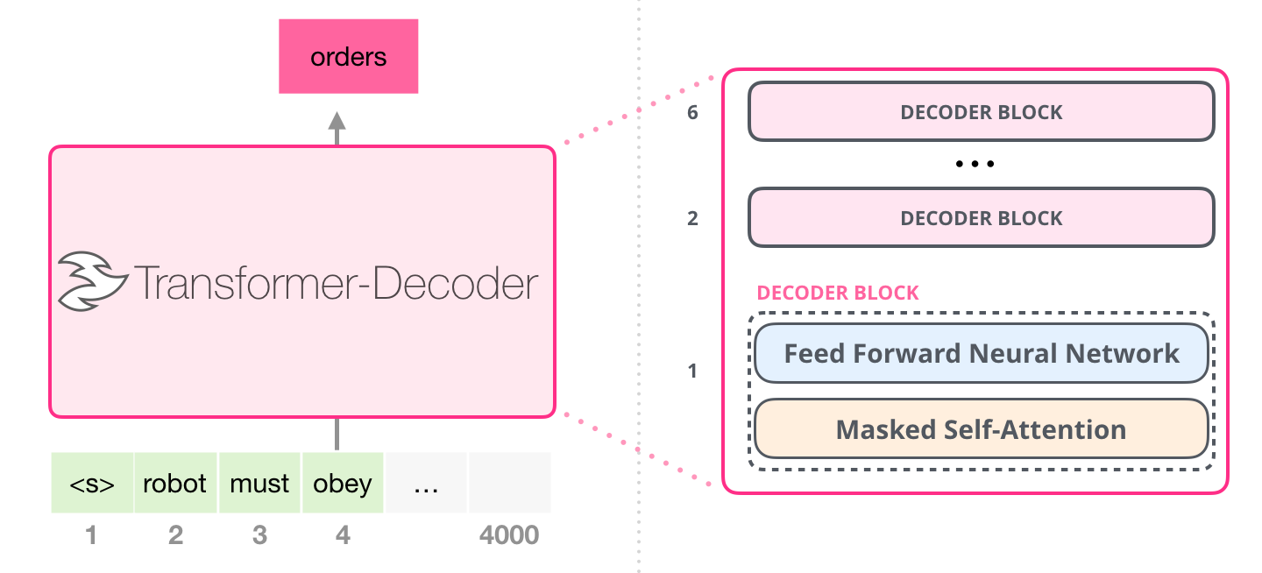
Modifications to Transformer Model
Modified arrangement capable of doing language modeling: throws away Transformer encoder.
This early transformer-based language model was made up of a stack of six transformer decoder blocks
Model now can address up to 4,000 tokens in a certain segment -- massive upgrade from the 512 in the original transformer
These blocks were very similar to the original decoder blocks, except did away with that second self-attention layer

Slide 11
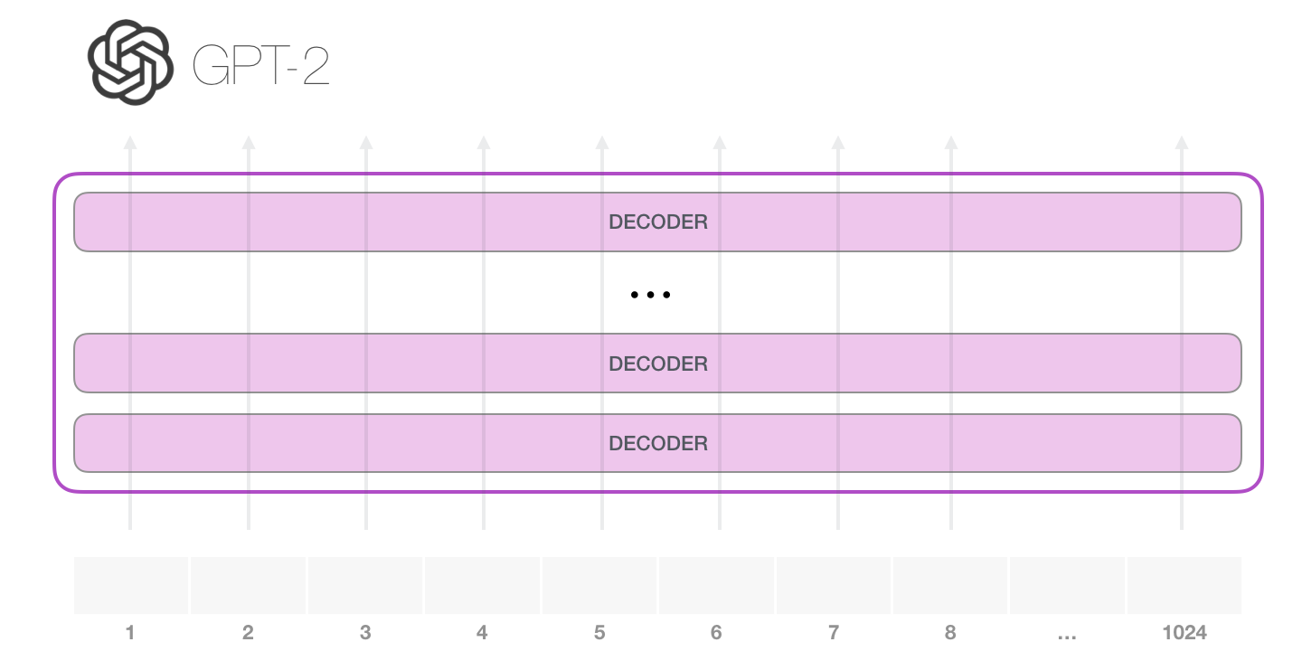
Architecture of GPT-2
Two ways to run a trained GPT-2
Generating unconditional samples: allow it to ramble on its own. Simply hand it start token and start generating words (the trained model uses <|endoftext|> as its start token)
Generating interactive conditional samples: give it a prompt to have it speak about a certain topic

Slide 12
Model only has one input token, so that path would be the only active one.
Token processed successively through all the layers, then a vector is produced along that path.
Vector scored against the model’s vocabulary (all the words the model knows, 50,000 words in the case of GPT-2).
Consider token with the highest probability, ‘the’.
Model sometimes can stuck in repetitive loops where the only way out is if you click the second or third suggested word.
GPT-2 has a parameter called top-k that we can use to have the model consider sampling words other than the top word (which is the case when top-k = 1).

Slide 13
Add the output from the first step to input sequence, and model makes next prediction
Second path is the only active one in this calculation.
Each layer of GPT-2 has retained its own interpretation of the first token and will use it in processing the second token
GPT-2 does not re-interpret the first token in light of the second token.

Slide 14
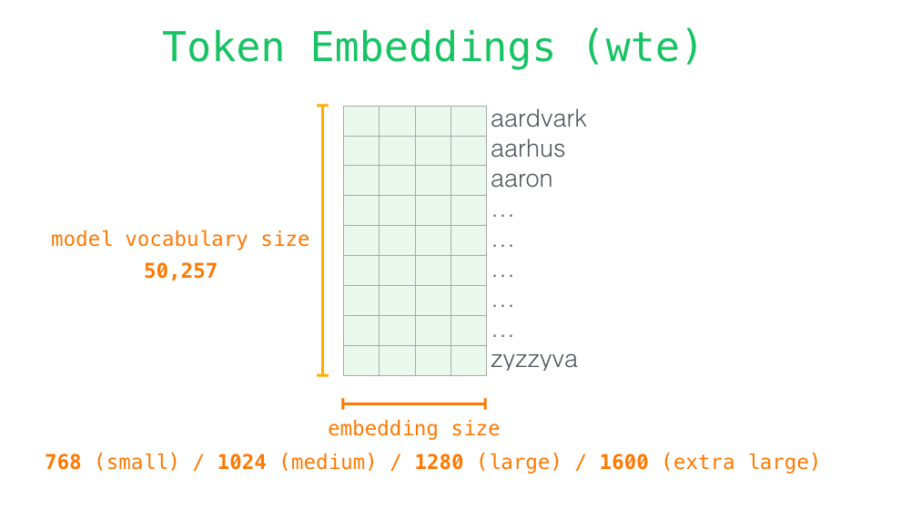
GPT 2 Working
Model looks up the embedding of the input word in its embedding matrix
Each row is a word embedding: a list of numbers representing a word and capturing some of its meaning.
The size of that list is different in different GPT2 model sizes. The smallest model uses an embedding size of 768 per word/token.

Slide 15
Byte Pair Encoding
Greedy frequency based heuristic for building the token vocabulary
Observed BPE including many versions of common words like dog since they occur in many variations such as dog. dog! dog? .
This results in a sub-optimal allocation of limited vocabulary slots and model capacity.
To avoid this, prevent BPE from merging across character categories for any byte sequence.
Added an exception for spaces which significantly improves the compression efficiency while adding only minimal fragmentation of words across multiple vocab tokens.

Slide 16

Working of BPE
Step 1
{'l o w </w>': 5, 'l o w e r </w>': 2, 'n e w e s t </w>': 6, 'w i d e s t </w>': 3}
Step 2
{'l o w </w>': 5, 'l o w e r </w>': 2, 'n e w es t </w>': 6, 'w i d es t </w>': 3}
Step 3
{'l o w </w>': 5, 'l o w e r </w>': 2, 'n e w est </w>': 6, 'w i d est </w>’: 3 }

Slide 17
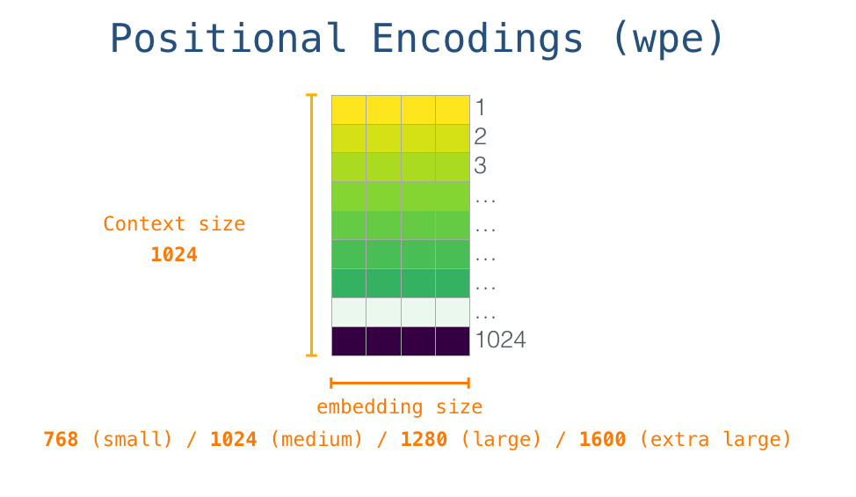
Positional Encoding
Look up the embedding of start token <s> in the embedding matrix.
Before handing that to the first block in the model, it incorporates positional encoding
Indicates the order of the words in the sequence to the transformer blocks. Part of the trained model is a matrix that contains a positional encoding vector for each of the 1024 positions in the input.

Slide 18
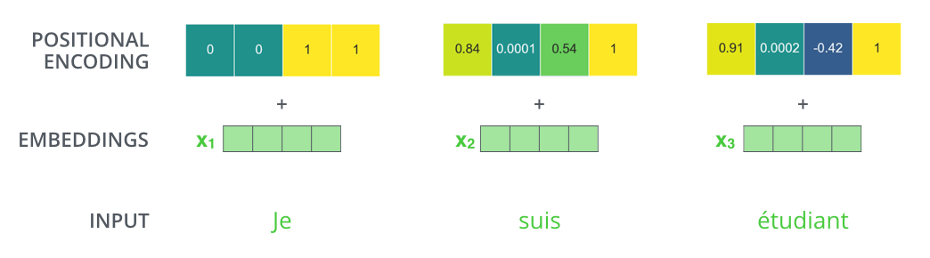
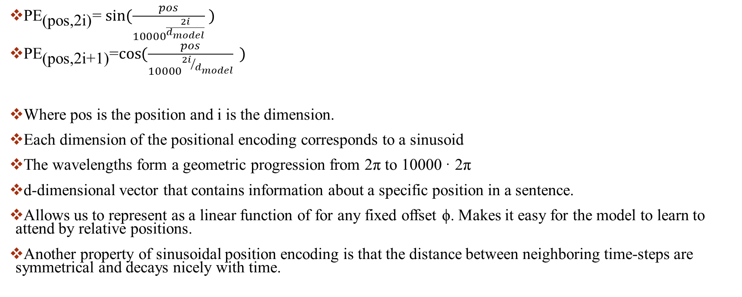
Positional Encoding formula
${\text{PE}}_{\text{(}\text{pos}\text{,2}\text{i}\text{)}}$= $\sin{(\frac{pos}{{10000}^{\frac{2i}{d_{model}}}} )}$
${\text{PE}}_{\text{(}\text{pos}\text{,2}\text{i}\text{+1}\text{)}}$=$\cos{(\frac{pos}{{10000}^{{2i}/{d_{model}}}}{ }}{)}$
Where pos is the position and i is the dimension.
Each dimension of the positional encoding corresponds to a sinusoid
The wavelengths form a geometric progression from 2π to 10000 · 2π
d-dimensional vector that contains information about a specific position in a sentence.
Allows us to represent as a linear function of for any fixed offset ϕ. Makes it easy for the model to learn to attend by relative positions.
Another property of sinusoidal position encoding is that the distance between neighboring time-steps are symmetrical and decays nicely with time.

Slide 19
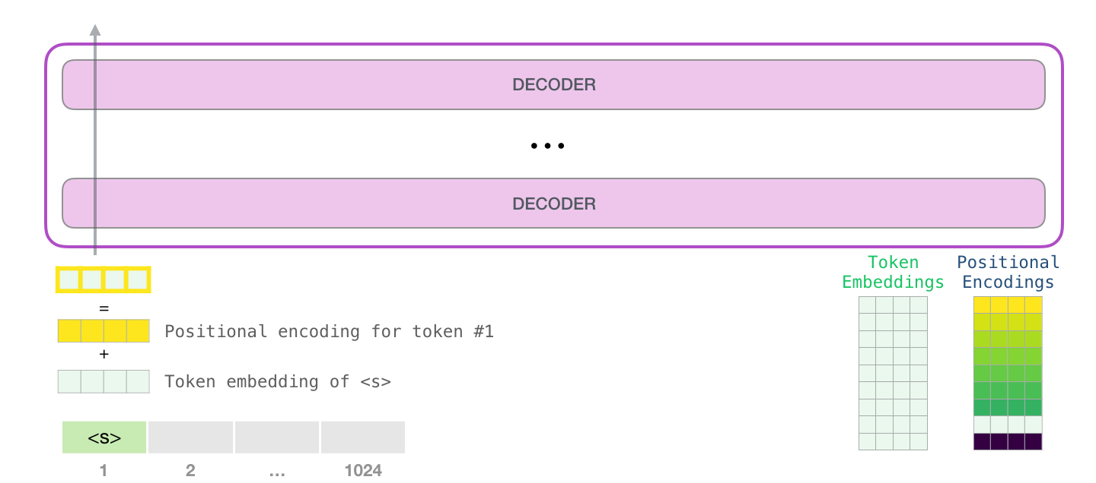
Sending a word to the first transformer block means looking up its embedding and adding up the positional encoding vector for position #1.

Slide 20
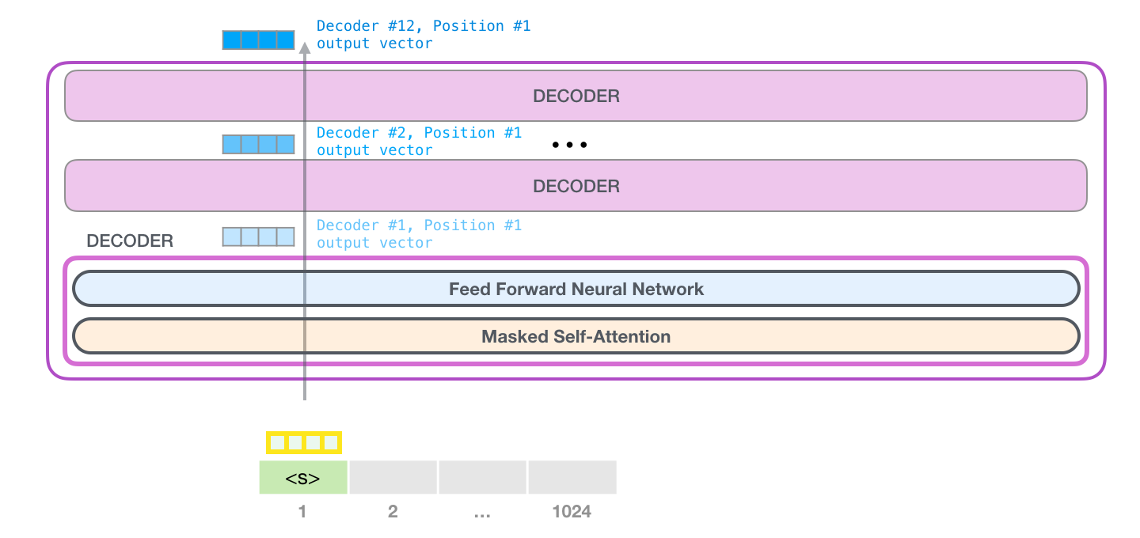
First block can now process the token by first passing it through the self-attention process, then passing it through its neural network layer
Once the first transformer block processes the token, it sends its resulting vector up the stack to be processed by the next block
Process is identical in each block, but each block has its own weights in both self-attention and the neural network sublayers

Slide 21
Context in Sentences
Second Law of Robotics “A robot must obey the orders given it by human beings except where such orders would conflict with the First Law.”
There is no way to understand or process these words without incorporating the context they are referring to.
it refers to the robot
such orders refers to the earlier part of the law, namely “the orders given it by human beings”
The First Law refers to the entire First Law

Slide 22
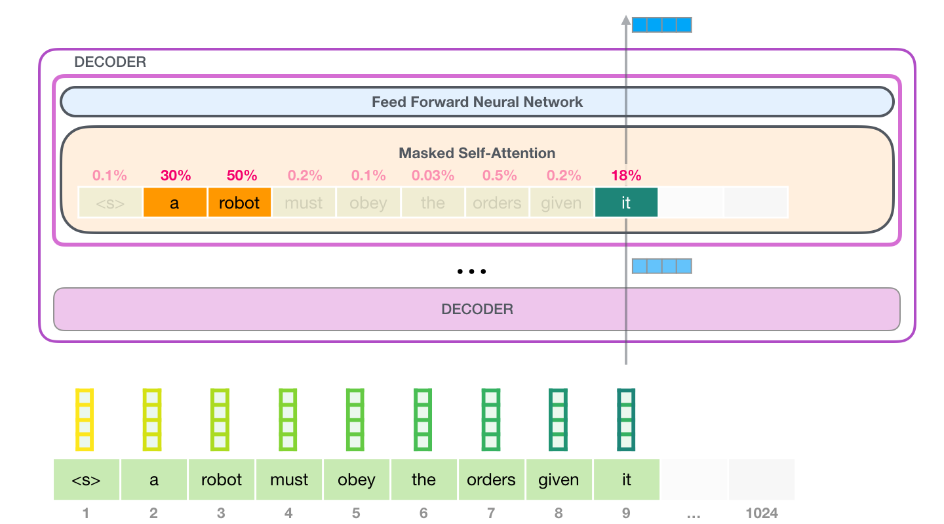
Self Attention Mechanism
Bakes in the model’s understanding of relevant and associated words that explain the context of a certain word before processing that word (passing it through a neural network)
Assigning scores to how relevant each word in the segment is, and adding up their vector representation.
Self-attention layer in the top block is paying attention to “a robot” when it processes the word “it”.
The vector “it” will pass to its neural network is a sum of the vectors for each of the three words multiplied by their scores.

Slide 23
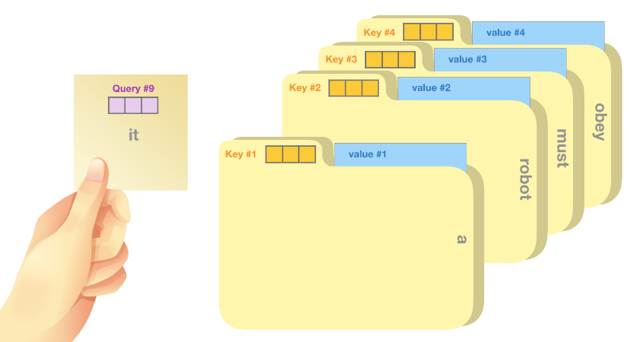
Calculating Self Attention
Query: Representation of the current word used to score against all the other words (using their keys). Only care about query of the token currently being processed.
Key: Key vectors are like labels for all the words in the segment. Match against them in search for relevant words.
Value: Value vectors are actual word representations, once scored how relevant each word is, these are the values added up to represent the current word.

Slide 24
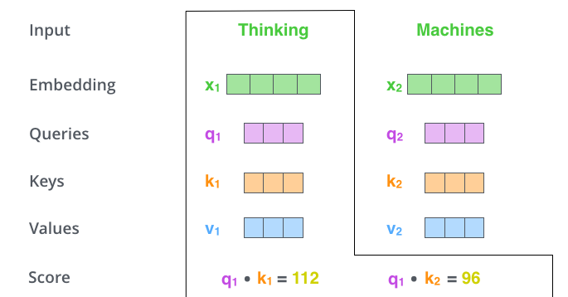
Score determines how much focus to place
Taking dot product of the query vector with the key vector of the respective word
Self-attention for the word in position #1
first score would be the dot product of q1 and k1.
The second score would be the dot product of q1 and k2.

Slide 25
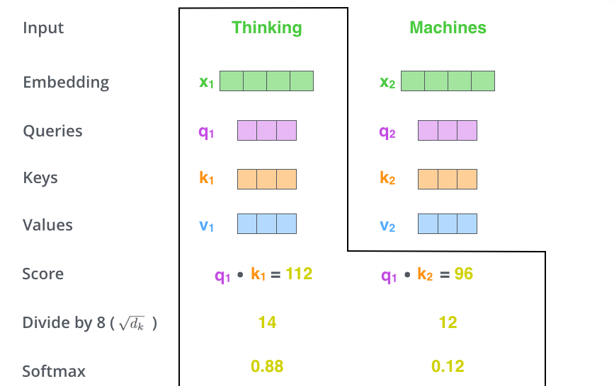
Divide the scores by square root of the dimension of the key vectors
Pass result through a softmax operation.
Softmax normalizes the scores so they’re all positive and add up to 1.
Softmax score determines how much each word will be expressed at this position

Slide 26
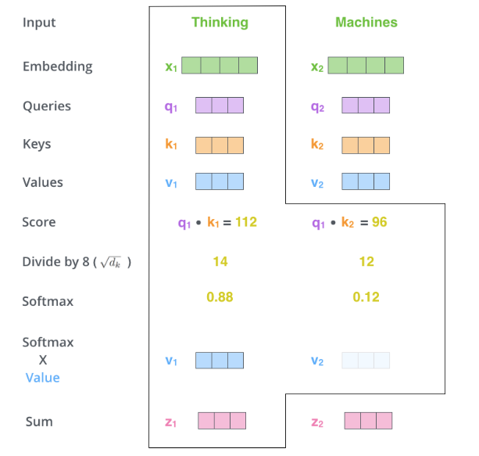
The fifth step is to multiply each value vector by the softmax score
The sixth step is to sum up the weighted value vectors.
Resulting vector is one we can send along to the feed-forward neural network
Calculation is done in matrix form for faster processing

Slide 27
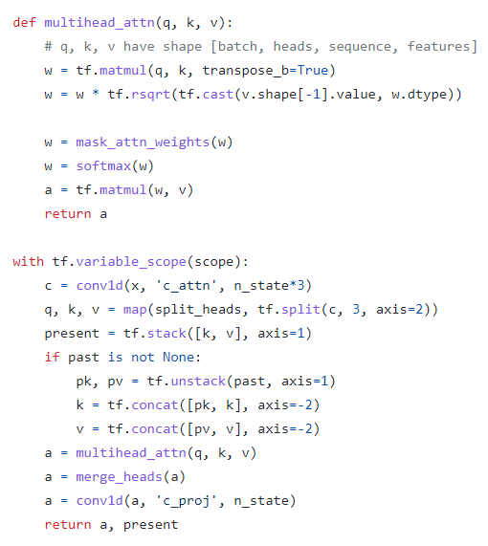

Slide 28
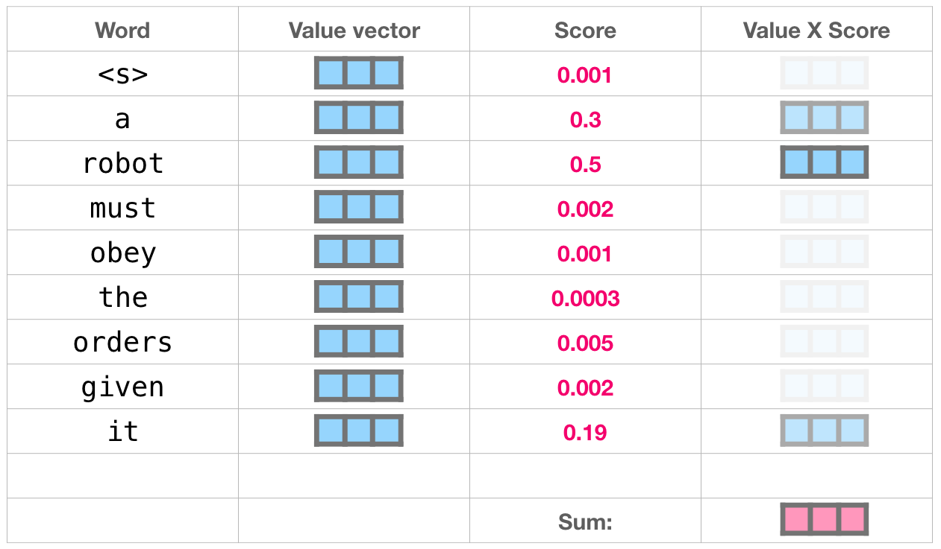
Multiply each value by its score and sum up – resulting in our self-attention outcome.
Weighted blend of value vectors results in a vector that paid 50% of its attention to “robot”, 30% to ”a”, and 19% to ”it”.

Slide 29
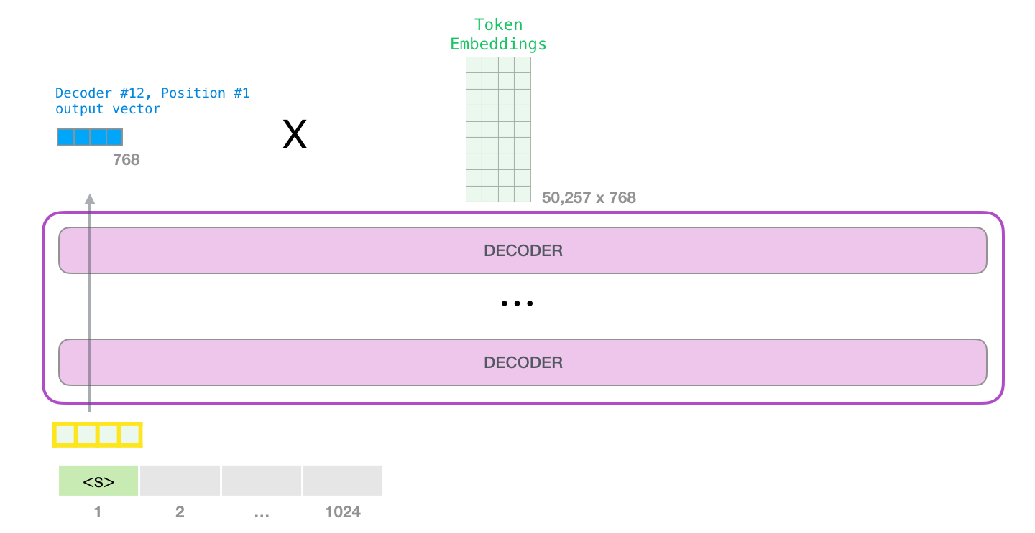
Output
When the top block in the model produces its output vector (the result of its own self-attention followed by its own neural network), the model multiplies that vector by the embedding matrix.

Slide 30
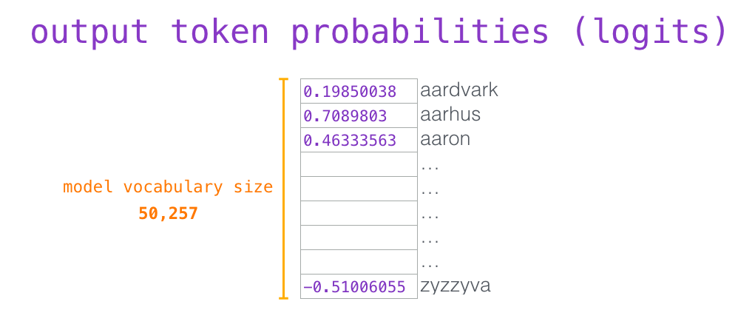
Each row in the embedding matrix corresponds to the embedding of a word in the model’s vocabulary.
The result of this multiplication is interpreted as a score for each word in the model’s vocabulary.

Slide 31
Simply select token with the highest score (top_k = 1).
But better results are achieved if the model considers other words as well.
So a better strategy is to sample a word from the entire list using the score as the probability of selecting that word (so words with a higher score have a higher chance of being selected).
A middle ground is setting top_k to 40, and having the model consider the 40 words with the highest scores.

Slide 32
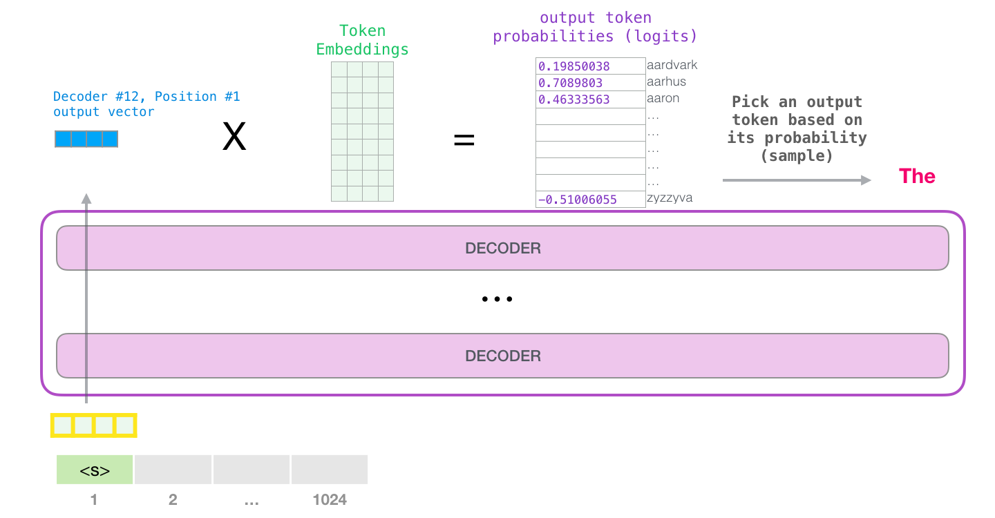
With that, the model has completed an iteration resulting in outputting a single word. The model continues iterating until the entire context is generated (1024 tokens) or until an end-of-sequence token is produced.

Slide 33
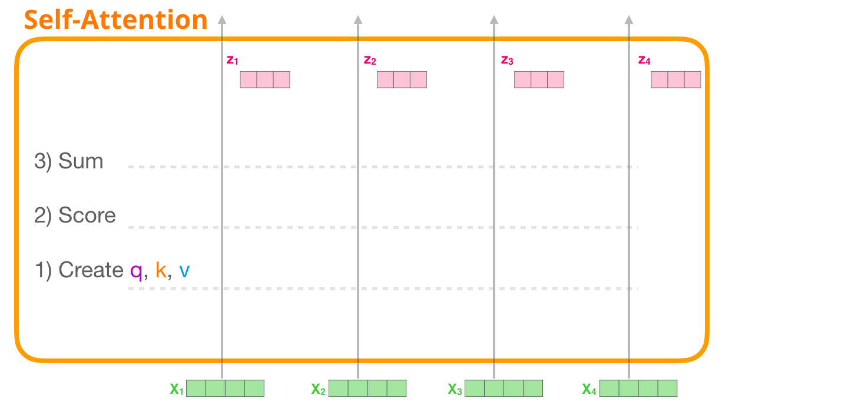
Calculating self attention
Self-attention is applied through three main steps:
Create the Query, Key, and Value vectors for each path.
For each input token, use its query vector to score against all the other key vectors
Sum up the value vectors after multiplying them by their associated scores.

Slide 34
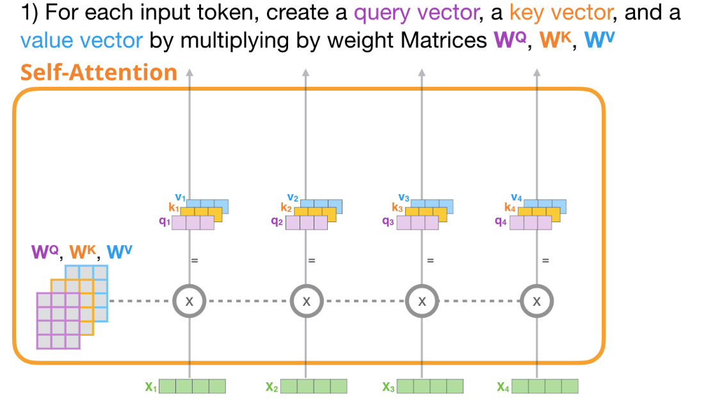
Create Query, Key, and Value Vectors
Take its query, and compare against all the keys.
Produces a score for each key.
The first step in self-attention is to calculate the three vectors for each token path (let’s ignore attention heads for now):

Slide 35
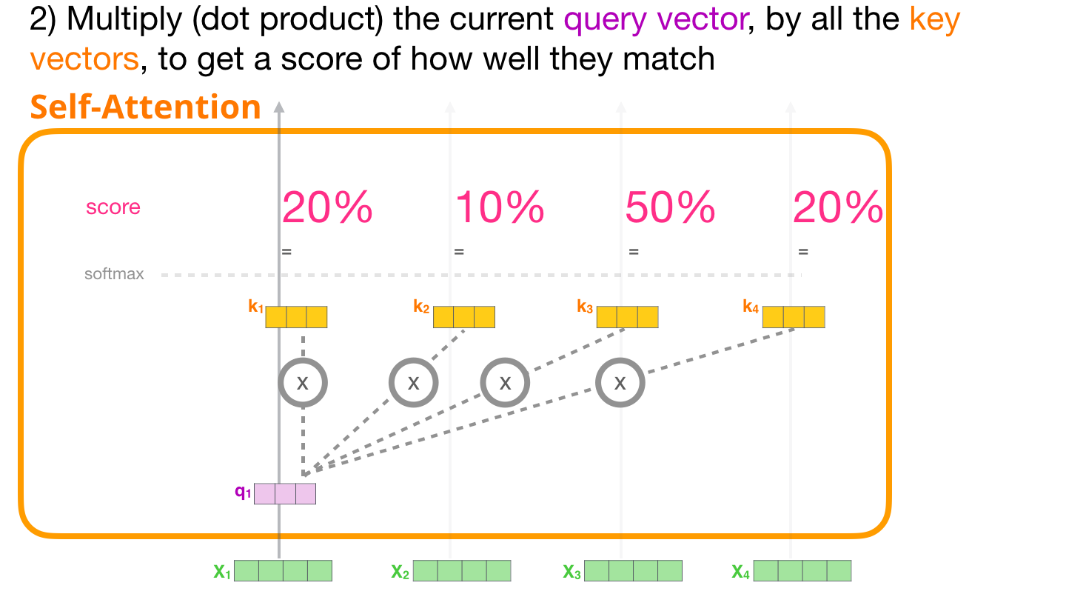
Use the query and key vectors only for step #2.
Since focused on the first token, we multiply its query by all the other key vectors resulting in a score for each of the four tokens.

Slide 36
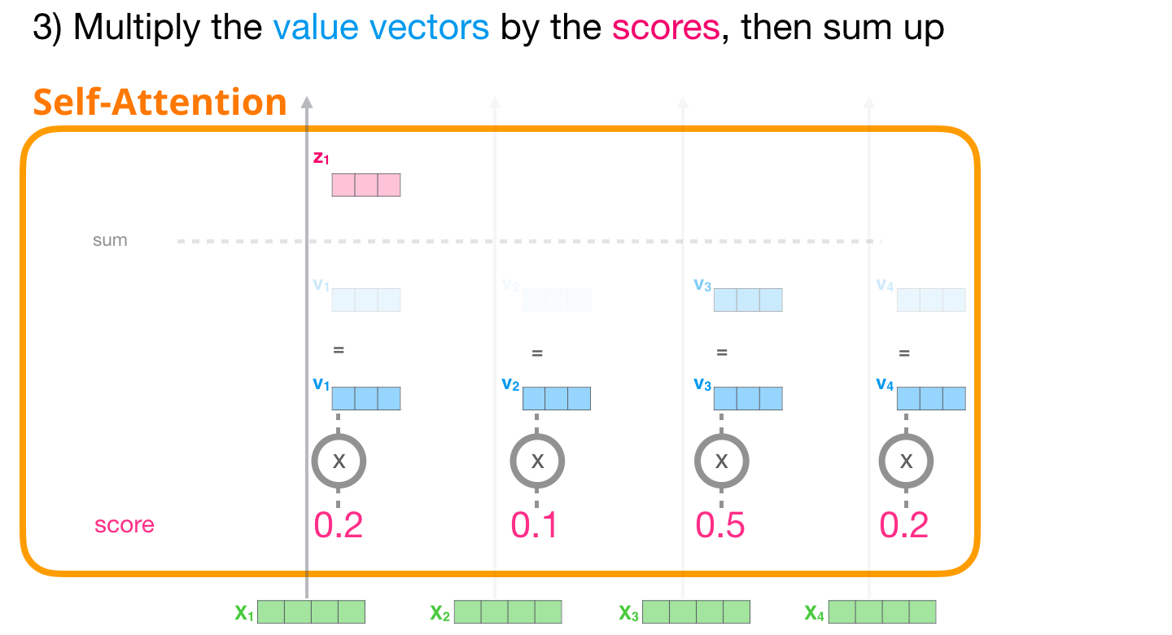
Multiply scores by the value vectors. A value with a high score will constitute a large portion of the resulting vector after we sum them up.
The lower the score, the more transparent the value vector is illustrated. That's to indicate how multiplying by a small number dilutes the values of the vector.

Slide 37
Same operation for each path, end up with a vector representing each token containing the appropriate context of that token. Those are then presented to the next sublayer in the transformer block (the feed-forward neural network):

Slide 38
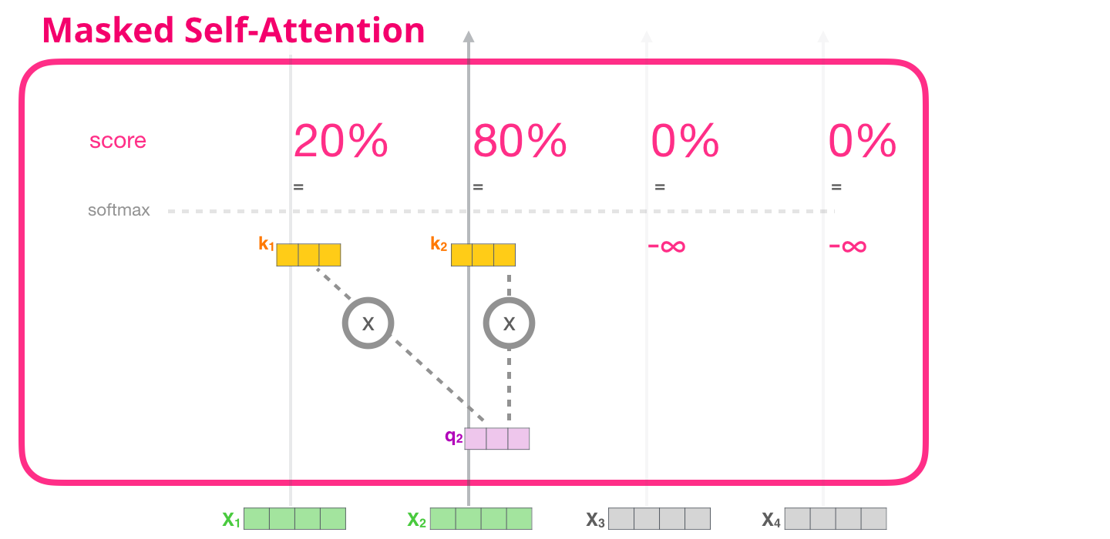
Masked self attention
Masked self-attention is identical to self-attention except when it comes to step #2.
Assuming the model only has two tokens as input and observing the second token.
In this case, the last two tokens are masked. So the model interferes in the scoring step. It basically always scores the future tokens as 0 so the model can’t peak to future words:

Slide 39
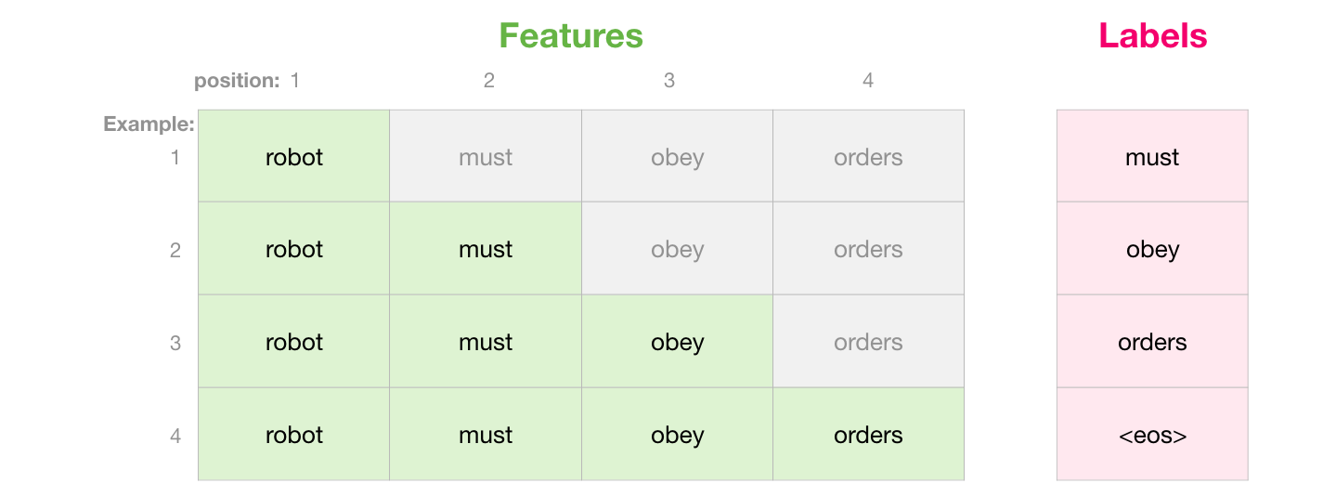
Masking is often implemented as a matrix called an attention mask.
Example sentence: “robot must obey orders”
In a language modeling scenario, this sequence is absorbed in four steps – one per word (assuming for now that every word is a token). As these models work in batches, we can assume a batch size of 4 for this toy model that will process the entire sequence (with its four steps) as one batch

Slide 40
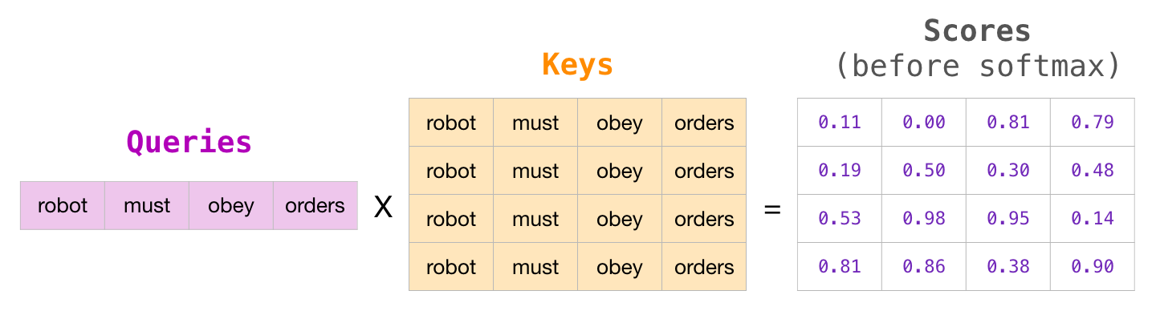
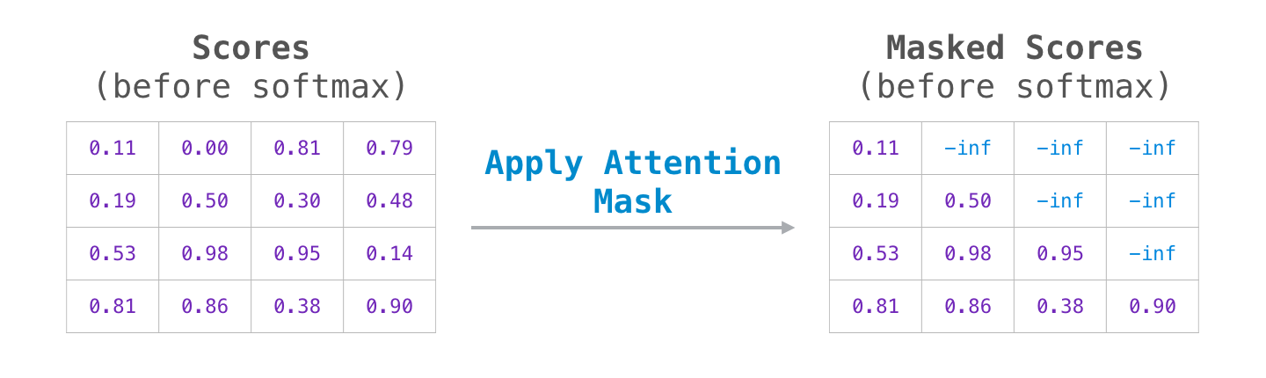
In matrix form, calculate the scores by multiplying a queries matrix by a keys matrix.
Instead of the word, there would be the query (or key) vector associated with that word in that cell:
After the multiplication, slap on attention mask triangle. It set the cells to mask to -infinity or a very large negative number (e.g. -1 billion in GPT2):

Slide 41
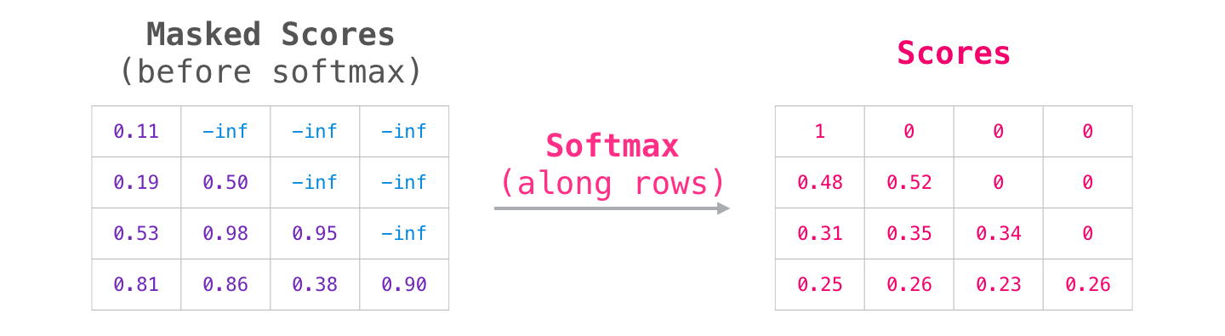
Then, applying softmax on each row produces the actual scores we use for self-attention
When the model processes the first example in the dataset (row #1), which contains only one word (“robot”), 100% of its attention will be on that word.
When the model processes the second example in the dataset (row #2), which contains the words (“robot must”), when it processes the word “must”, 48% of its attention will be on “robot”, and 52% of its attention will be on “must”.
And so on

Slide 42
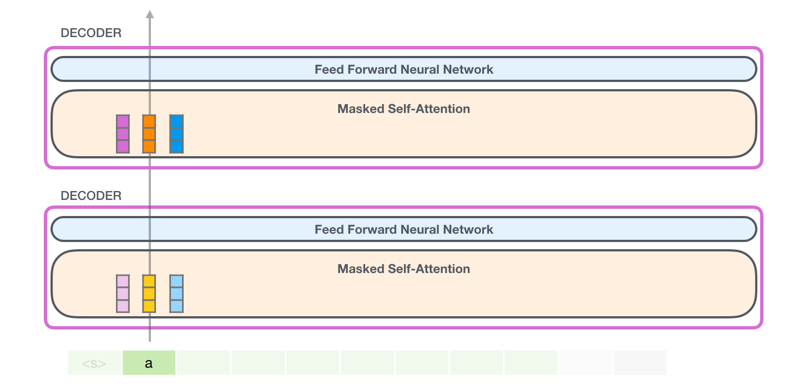
Inefficiency of Masked Self-Attention
It would be inefficient to recalculate self-attention along earlier paths for tokens which have already been processed.
Process the first token (ignoring <s> for now)

Slide 43
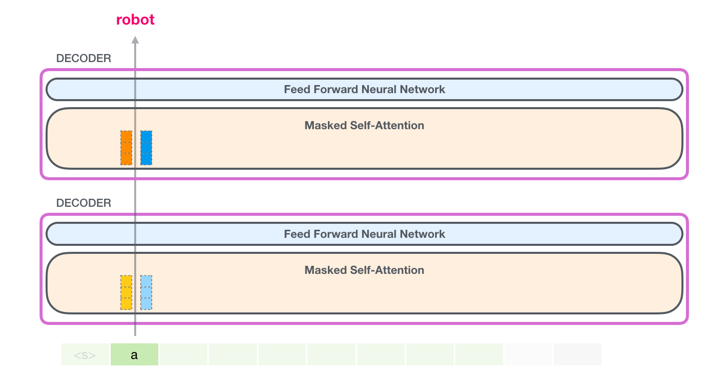
GPT-2 holds on to the key and value vectors of the “a” token. Every self-attention layer holds on to its respective key and value vectors for that token:

Slide 44
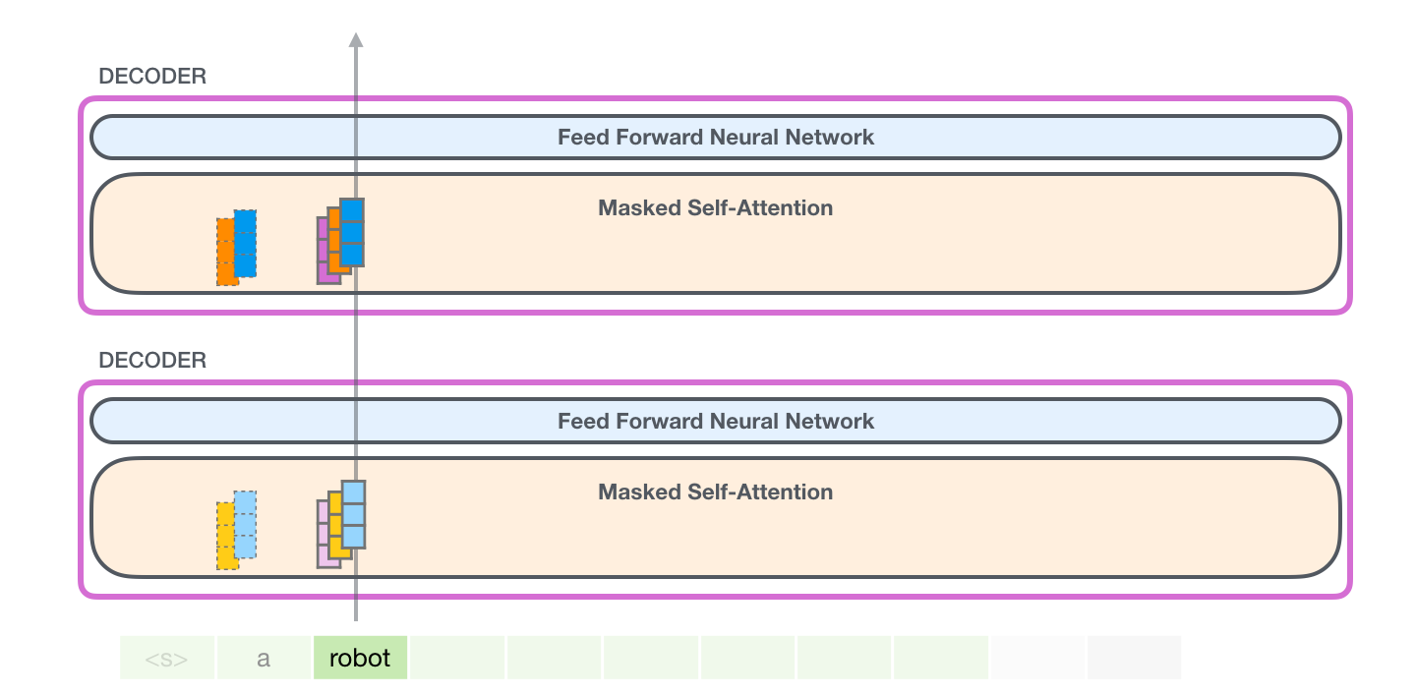
Now in the next iteration, when the model processes the word robot, it does not need to generate query, key, and value queries for the a token. It just reuses the ones it saved from the first iteration:

Slide 45
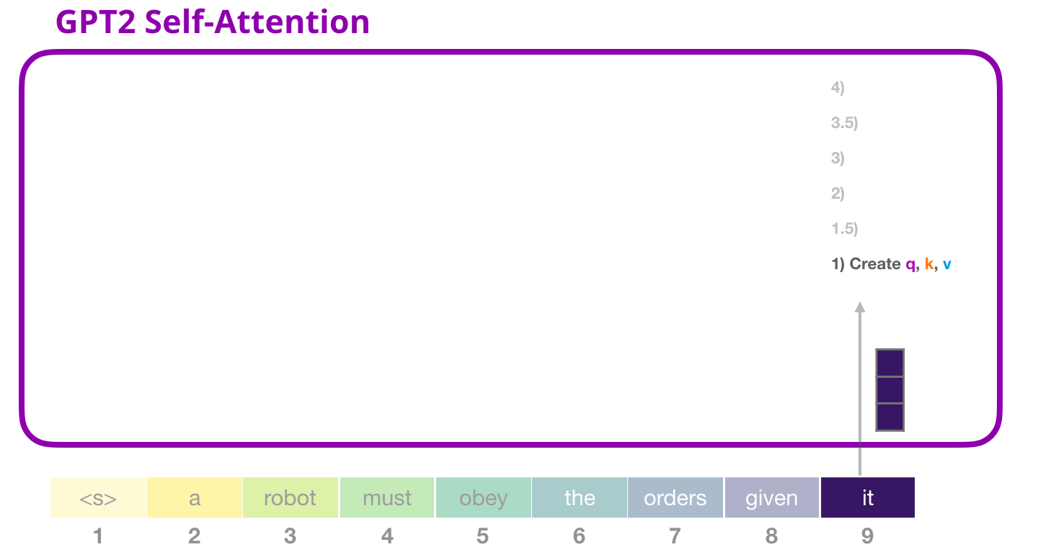
Processing Example
Let’s assume the model is processing the word “it”.
For the bottom block, input for that token would be the embedding of it + the positional encoding for slot #9:

Slide 46
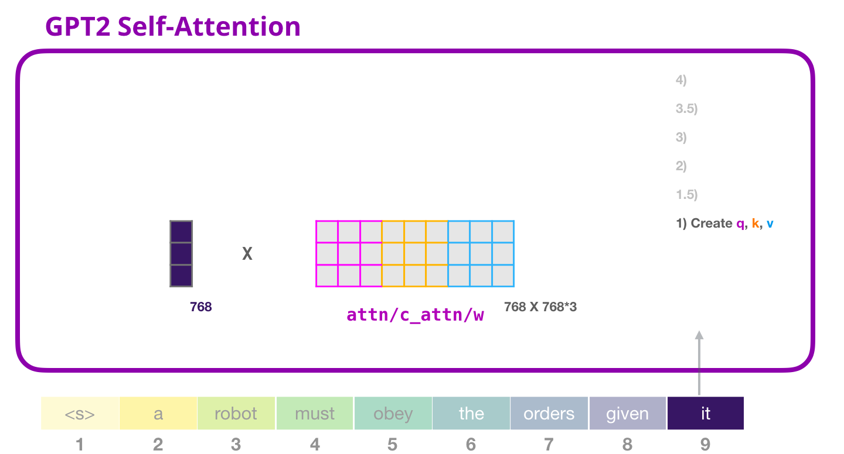
Every block in a transformer has its own weights.
The first matrix is the weight matrix that is used to create the queries, keys, and values.

Slide 47
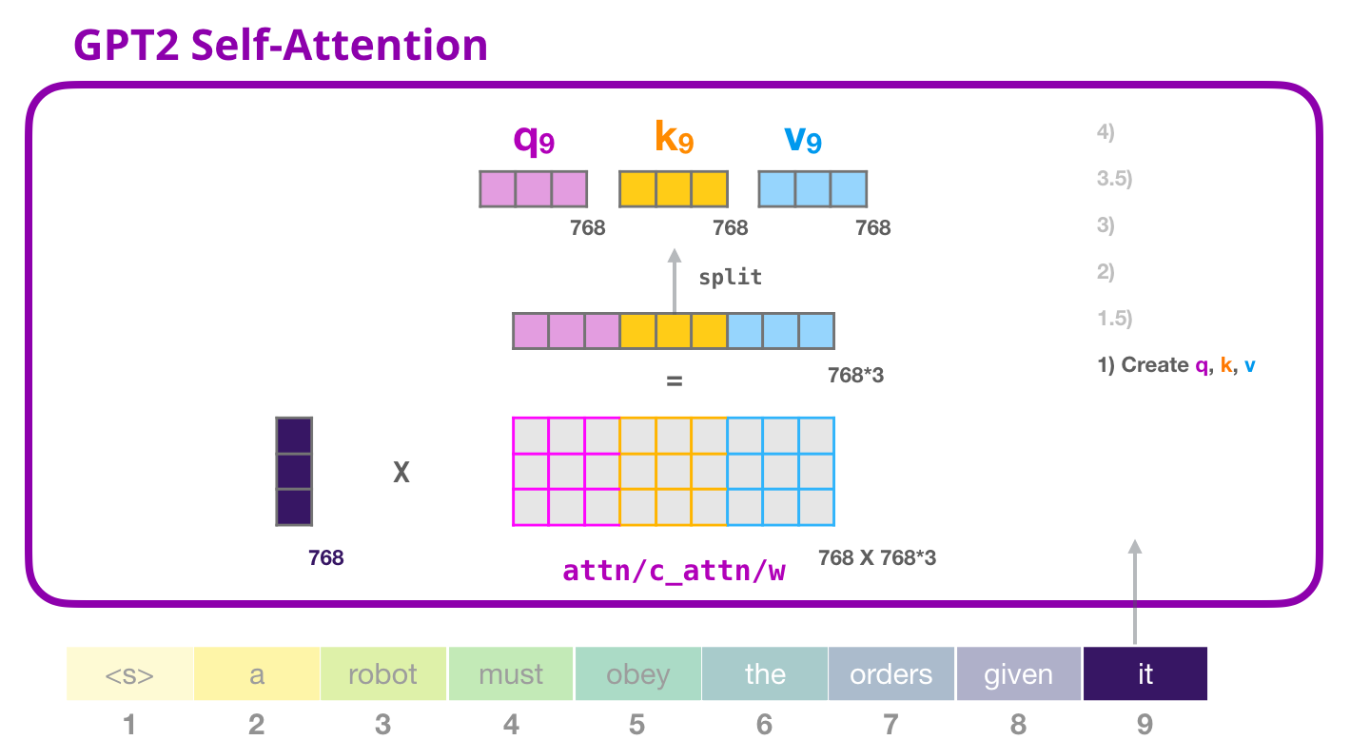
The multiplication results in a vector that’s basically a concatenation of the query, key, and value vectors for the word it.

Slide 48
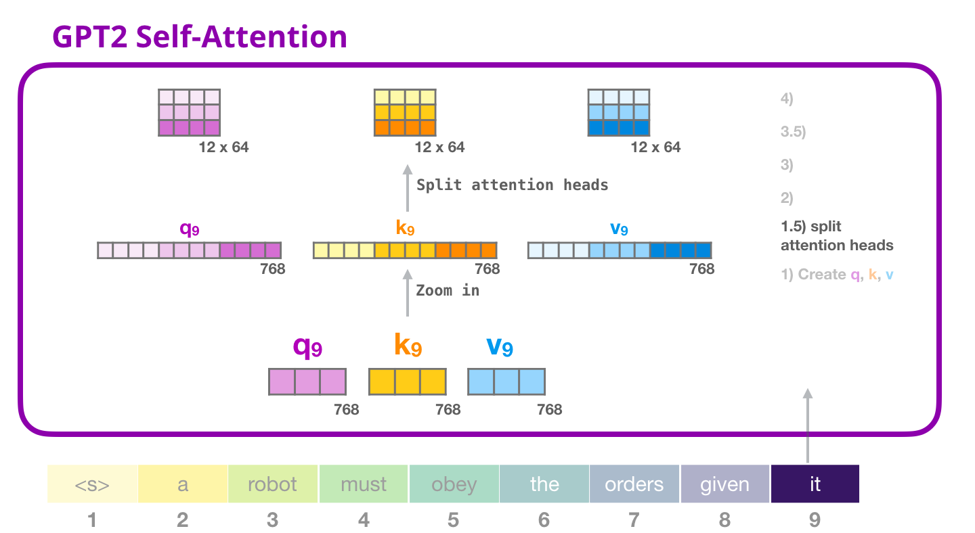
Multi-head Attention
Self attention is conducted multiple times on different parts of the Q,K,V vectors.
Reshaping the long vector into a matrix.
The small GPT2 has 12 attention heads, so that would be the first dimension of the reshaped matrix:

Slide 49
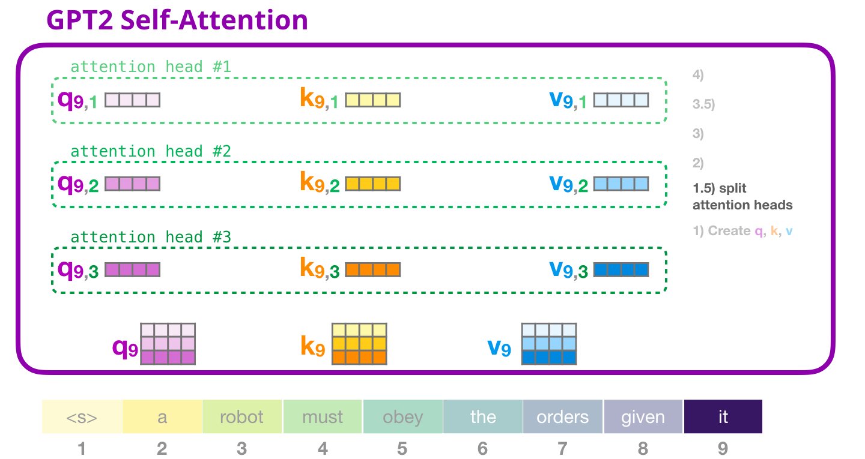
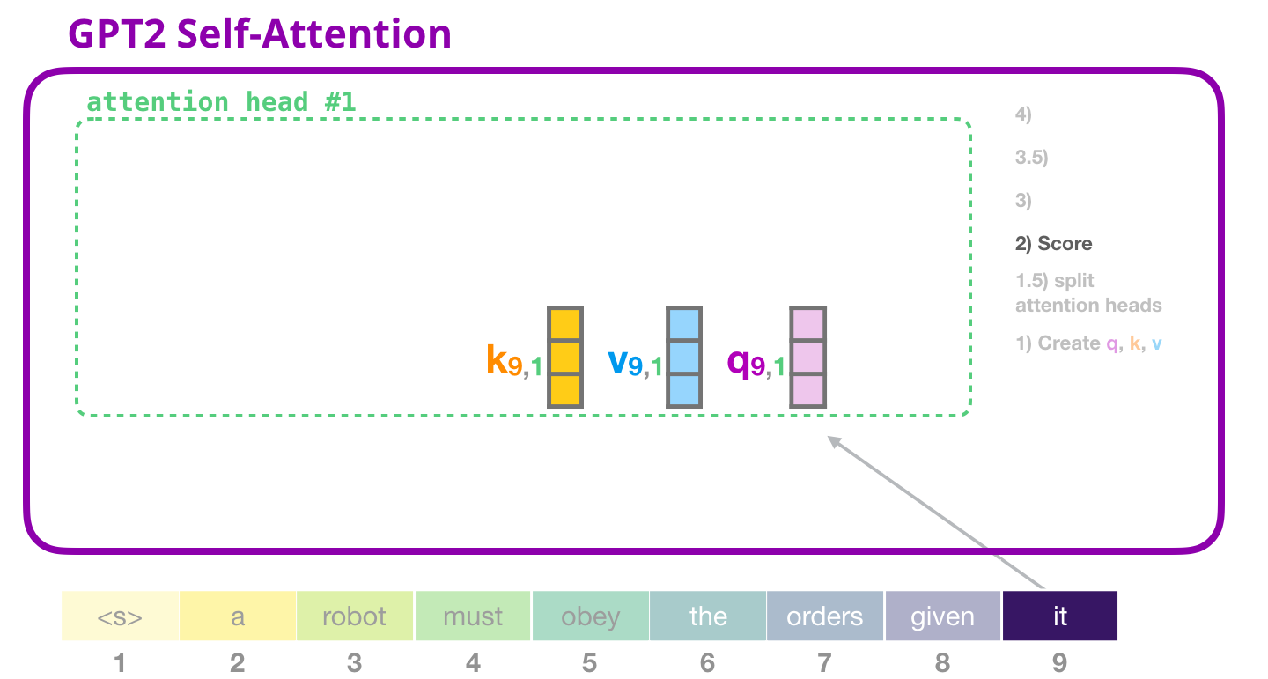
Visualizing multiple attention-heads is as follows

Slide 50
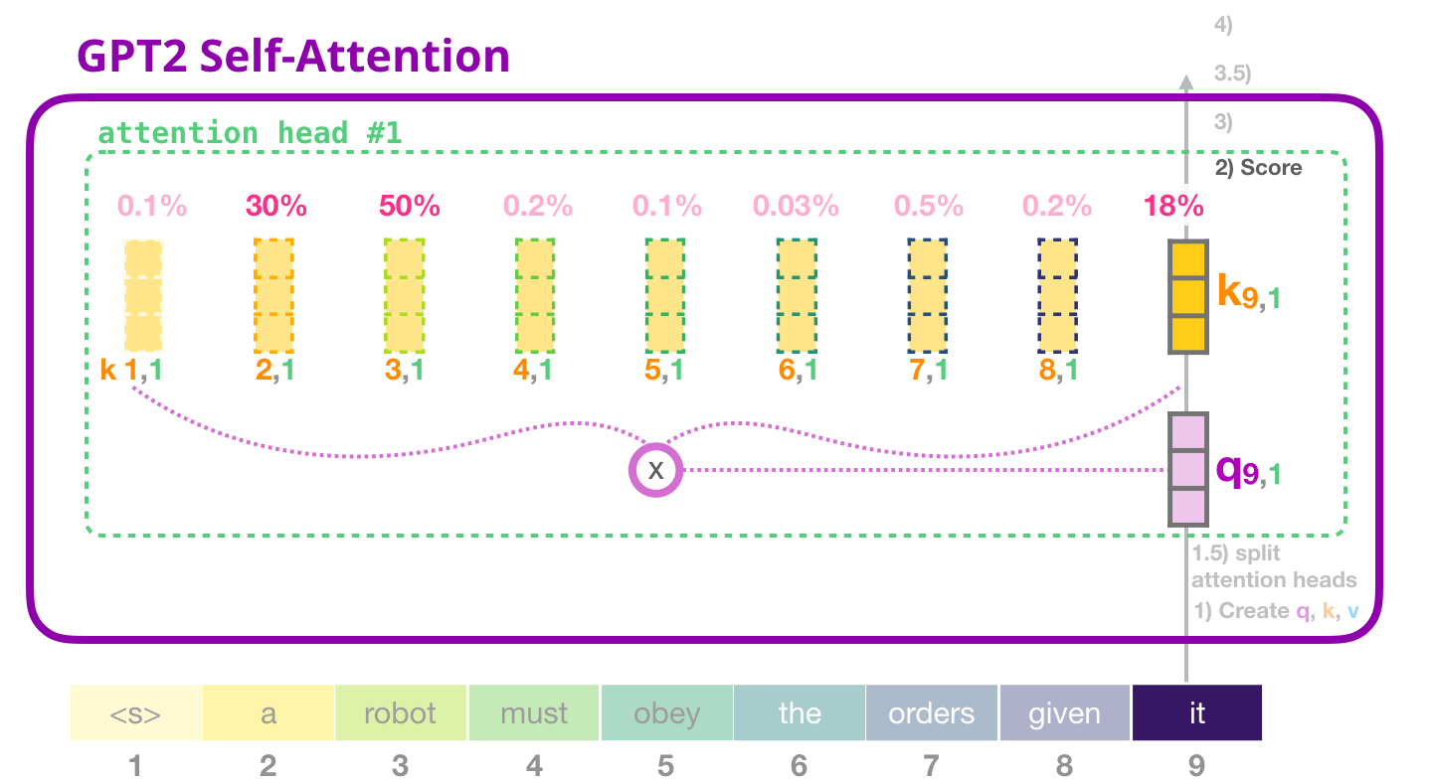
Now the token can get scored against all of keys of the other tokens (that were calculated in attention head #1 in previous iterations):

Slide 51
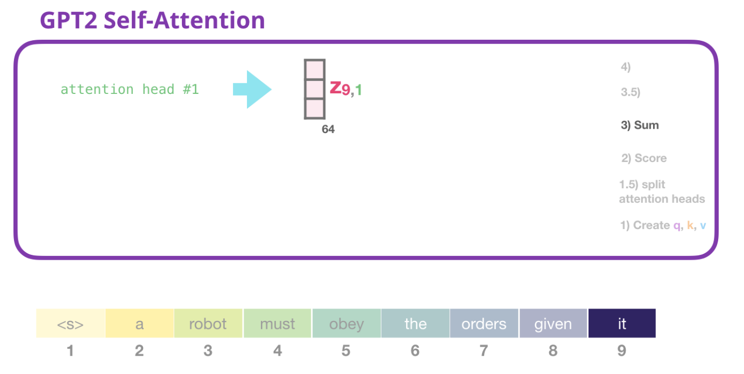
Multiply each value with its score, then sum them up, producing the result of self-attention for attention-head #1:

Slide 52
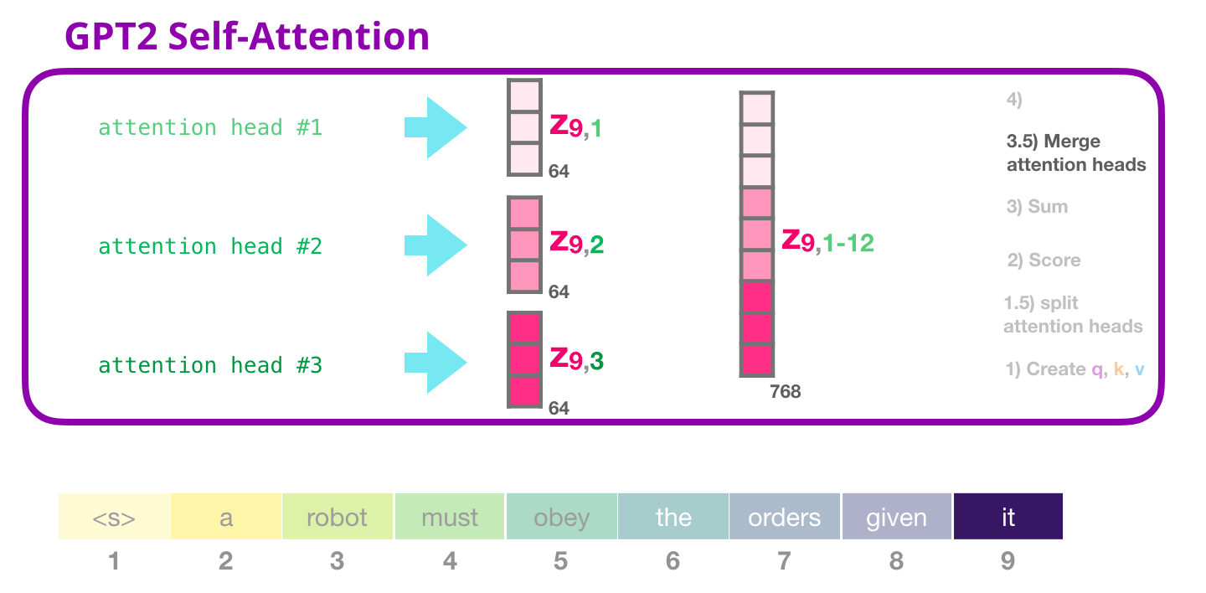
Dealing with various attention heads is first concatenate them into one vector:
But the vector isn’t ready to be sent to the next sublayer just yet. We need to first turn this into a homogenous representation.

Slide 53
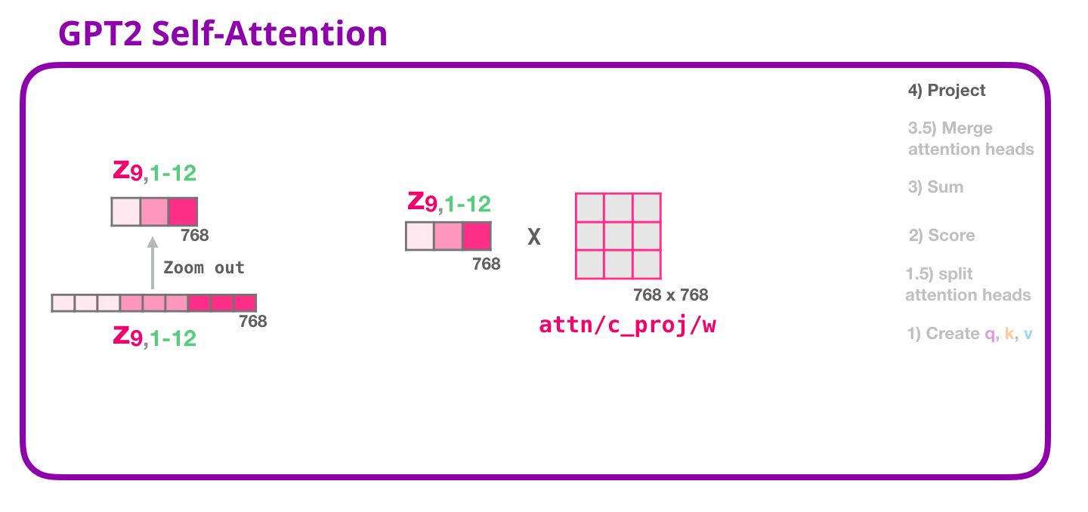
Map concatenated self-attention results into a vector that the feed-forward neural network can deal with.
The next large weight matrix that projects the results of the attention heads into the output vector of the self-attention sublayer:

Slide 54
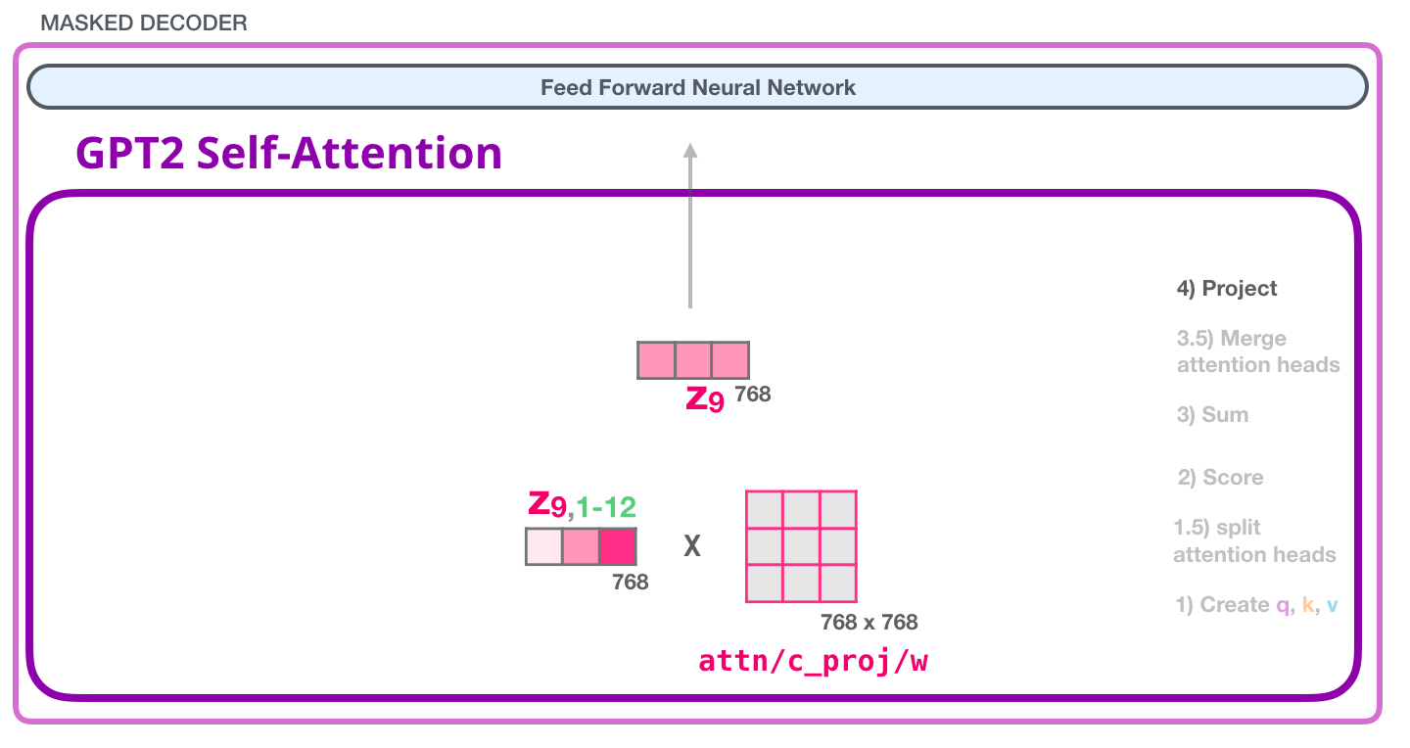
This vector is sent to the next layer:
The fully-connected neural network is where the block processes its input token after self-attention has included the appropriate context in its representation.
It is made up of two layers.

Slide 55
The first layer is four times the size of the model (Since GPT2 small is 768, this network would have 768*4 = 3072 units).
Size the original transformer rolled with (model dimension was 512 and layer #1 in that model was 2048). Gives transformer models enough representational capacity to handle the tasks that have been thrown at them so far.

Slide 56
The second layer projects the result from the first layer back into model dimension (768 for the small GPT2). The result of this multiplication is the result of the transformer block for this token.

Slide 57
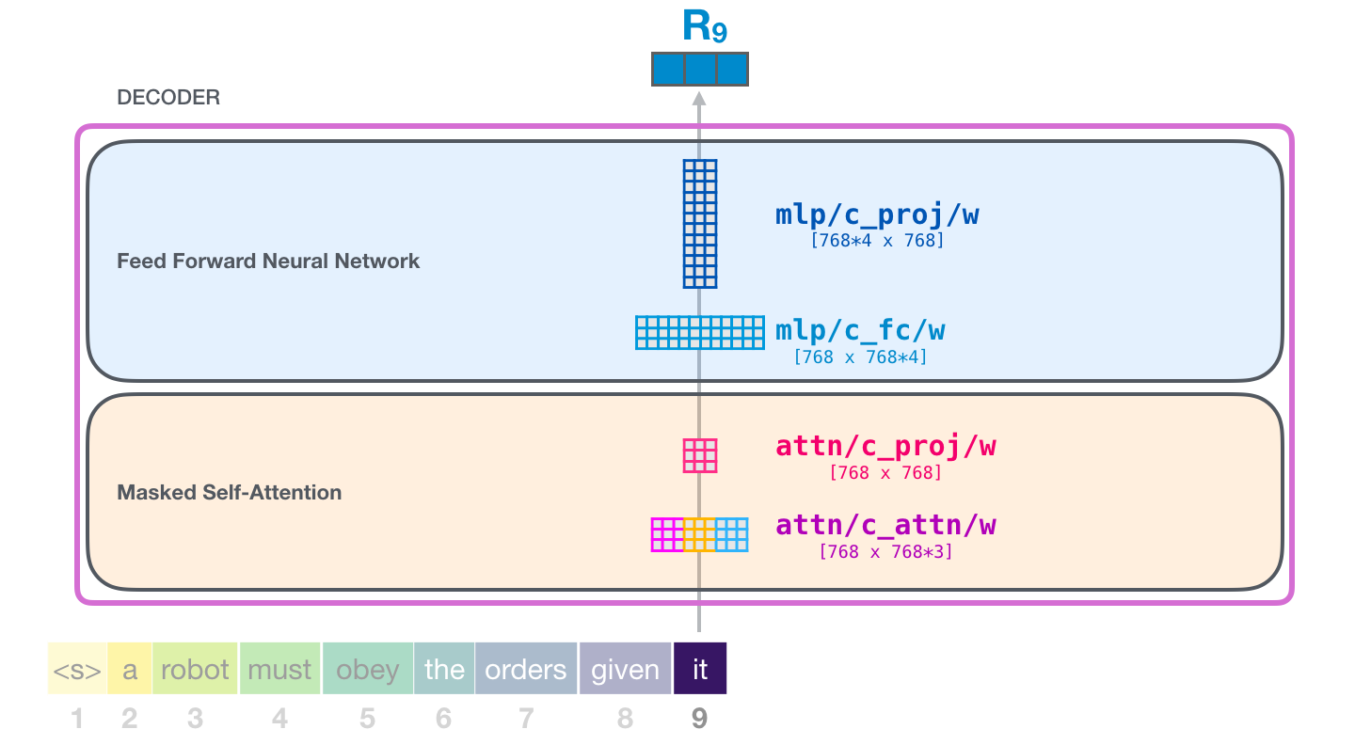
Input vector encounters these weight matrices

Slide 58
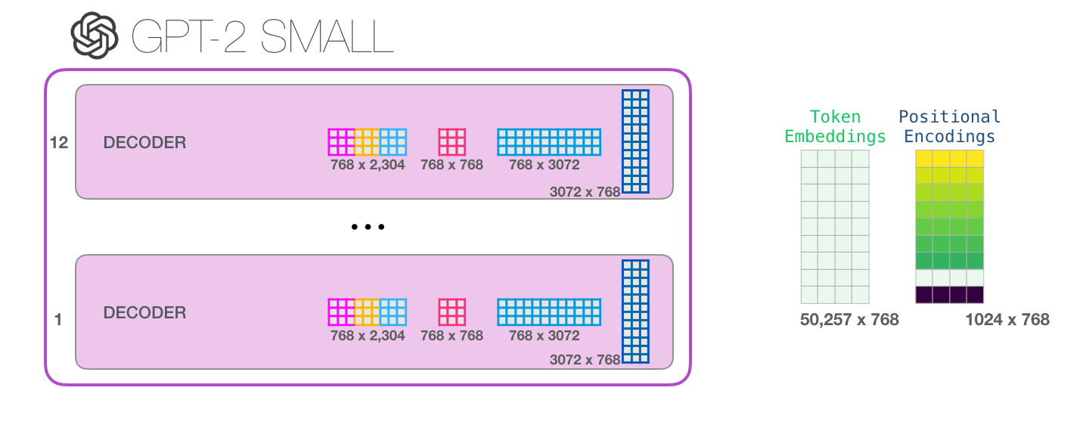
And each block has its own set of these weights. On the other hand, the model has only one token embedding matrix and one positional encoding matrix:

Slide 59

All parameters of the model: adds up to 124M

Slide 60
References
https://openai.com/blog/better-language-models/
http://jalammar.github.io/illustrated-gpt2/

